Slide 1
CD INDLELA/NAD
(NAMB)
National Artisan Moderation Body
Accreditation of TTCs and SPDs Registration of Assessors and Moderators

Slide 2
Background
CHAPTER 6A
ARTISAN DEVELOPMENT: NATIONAL ARTISAN MODERATION BODY
(As per Government Gazette no 31666, 1 December 2008; Act no 37 of 2008 Skills Development Amendment Act)
26A. (1) The Director-General must—
(a) establish a national artisan moderation body in the Department; and
(b) provide the body contemplated in paragraph (a) with the personnel
and financial resources that are necessary to coordinate artisan
development in the Republic.
(2) The functions of the national artisan moderation body are to—
(a) monitor the performance of accredited artisan trade test centres;
(b) moderate artisan trade tests;
(c) develop, maintain and apply a national data-bank of instruments for
assessment and moderation of artisan trade tests;
(d) develop and maintain a national data-base of registered artisan trade assessors and moderators;
(e) record artisan achievements;
(f) determine appeals against assessment decisions;
(g) recommend the certification of artisans to the QCTO; and
(h) perform any other prescribed function.

Slide 3
Purpose of Accreditation
To ensure a common standard for the delivery of training and/or testing of artisan learners across all sectors and the effective quality assurance by the QCTO through performance monitoring of Skills Development Providers (SDPs) and Trade Test Centres (TTCs) by the NAMB.

Slide 4
Accreditation of Skills Development Providers
All SDPs delivering trade training for any of the curriculum components:
Occupational knowledge component
Practical skills component
… of any occupation listed as a trade must be accredited by the QCTO on the recommendation of the NAMB.

Slide 5
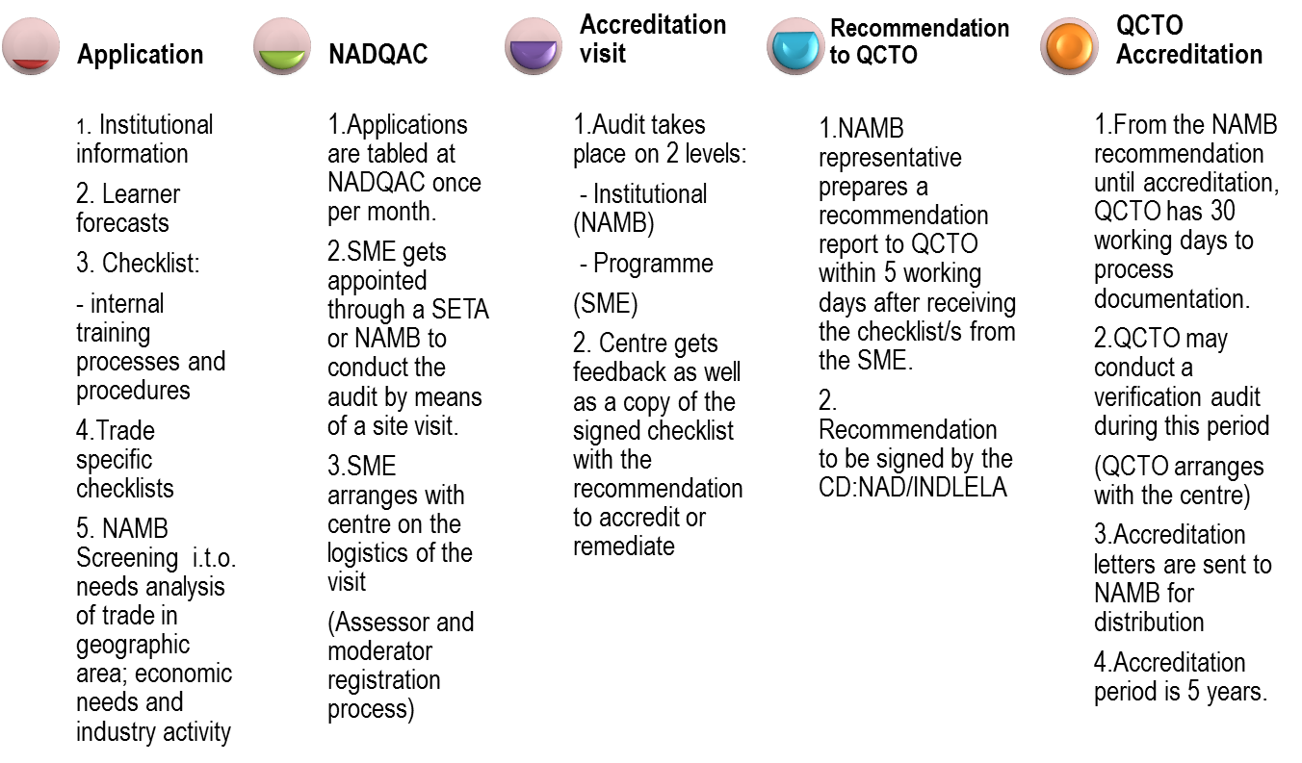
Process of Accreditation for SDPs

Slide 6
Accreditation of Trade Test Centre
Any centre seeking accreditation must comply with the following criteria:
The trade test area must be separate from the training area, only candidates and assessment practitioners attending trade tests must be allowed into the trade testing area.
Dedicated equipment for trade testing has to be available where disassembly, assembly, inspection, fault finding or adjustments are performed. (specific checklists)
Trade tests and moderations must not be conducted by the trainers who have conducted the artisan training to the same candidate or candidates.
No disturbances must be present during the trade testing which will impact or influence the candidate during the trade test.

Slide 7
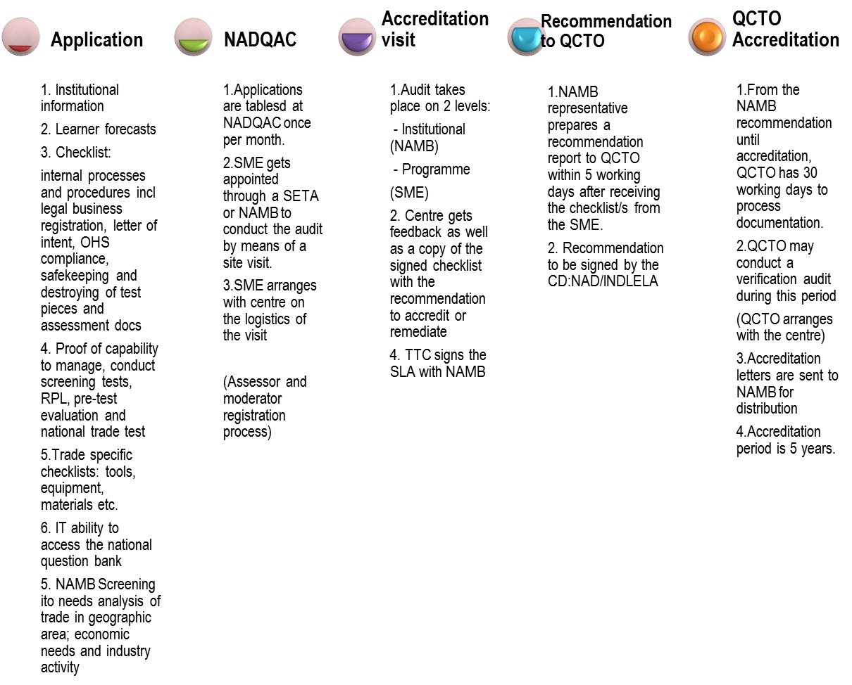
Process of Accreditation of TTCs

Slide 8
SLA between TTCs and NAMB
The parties to this SLA seek to, through collaborations, assistance and mutual support, implement a National Non-sector based trade testing and Quality Assurance system for artisan development in the Republic.
The signing of this SLA is a pre-requisite for a prospective Trade Test Centre to be recommended by NAMB for accreditation by the Quality Council for Trades and Occupations (QCTO) unless NAMB approves exemption from the signing thereof based on written submission submitted by the Trade Test Centre.
DURATION OF THE AGREEMENT
From Accreditation continuous, unless de-accredited.

Slide 9
Registration of assessors and moderators
To ensure the credibility of trade test assessments conducted, all assessors and moderators conducting trade test assessments and moderations of trade test assessments will be registered by the NAMB as an Assessment Quality Partner for trades of the QCTO.
A pre-requisite for accreditation of a TTC is the suitability of the human resources, i.e. assessors and moderators in the employed by the TTC.

Slide 10
Registration of Assessors
Assessors
Registered practicing artisan in the specific trade.
At least 3 years relevant industry experience, working as an artisan in the specific trade.
At least 2 years relevant practical training experience in the specific trade
Must be trained as an artisan assessor and deemed competent to conduct trade tests.
Must be employed at an artisan trade test centre accredited by the QCTO to conduct trade test or centre applying to be accredited.
Registration of 3 years as an artisan trade assessor will be awarded should the criteria be met.

Slide 11
Registration of Moderators
Moderator
At least 3 years experience as a registered artisan trade assessor in a relevant and related trade within the same trade family for which registration as moderator is applied for.
Must be trained as an artisan moderator and deemed competent to conduct moderations of trade tests.
Must be employed at a QCTO accredited artisan trade test centre QCTO to conduct trade tests or apply to be registered as a constituent moderator of the NAMB.
Registration of 3 years as an artisan trade moderator will be awarded should the criteria be met.

Slide 12
Registration of assessors and moderators
Application form requested
Memo to Chief Director for signature (± 3 days)
Documents received
Application form sent
Yes
NAMB check compliance of application against criteria
Copy of signed docs sent to applicant via email (originals to be picked up from NAMB)
Request for additional information via email
No
End

Slide 13
Contact details
Accreditation:
James Ditshoene – ditshoene.j@dhet.gov.za
Mmadira Seima – seima.p@dhet.gov.za
Registration:
Thabang Mokori – mokori.t@dhet.gov.za
Happy Zwane – zwane.h@dhet.gov.za
Muzi Zulu – zulu.p@dhet.gov.za
Deputy Director: Accreditation and Registration:
Heilene Steenkamp – steenkamp.h@dhet.gov.za

Slide 14
Questions

